Slide 1
RED BLACK TREES
RB-Trees

Slide 2
Red Black Tree is a type of self balancing binary search tree
It is invented in 1972 by Rudolf Bayer who called it “symmetric binary B-Trees”
Each node of this tree has an extra attribute ‘color’ which can be RED or BLACK
Coloring of nodes ensures that longest path from root to a leaf is no longer then twice the length of a shortest path which means the tree is balanced

Slide 3
AVL Vs RB Tree
Parameter | AVL Tree | R-B tree
Balance Factor | AVL trees are more strictly balanced compared to RB trees. In AVL trees, the balance factor (the height difference between the left and right subtrees) of every node is restricted to be at most 1, ensuring a height-balanced tree. | RB trees have less strict balance requirements. They ensure that the tree remains approximately balanced by coloring the nodes (red or black) and enforcing several properties.
Insertion and Deletion | Insertions and deletions in AVL trees typically require more rotations, which can make them slower for these operations. Balancing an AVL tree can take multiple rotations in some cases. | RB trees require fewer rotations during insertion and deletion, making them more efficient for dynamic datasets where elements are frequently added or removed. RB trees are considered more practical for use in databases and file systems where there are many insertions and deletions.

Slide 4
AVL Vs RB Tree
Parameter | AVL Tree | R-B tree
Performance Considerations | AVL trees are well-suited for scenarios where read operations significantly outnumber write operations, as their read performance is generally better due to their stricter balance criteria. | RB trees are preferred when the dataset is more dynamic, and there are frequent insertions and deletions. Their performance is often better in situations with a mix of read and write operations, and they are commonly used in real-time systems.
Code Complexity | AVL trees tend to have more complex code for maintaining balance, which can lead to larger codebases and potentially more room for bugs. | RB trees are usually easier to implement, maintain, and debug due to their simpler balance maintenance.

Slide 5
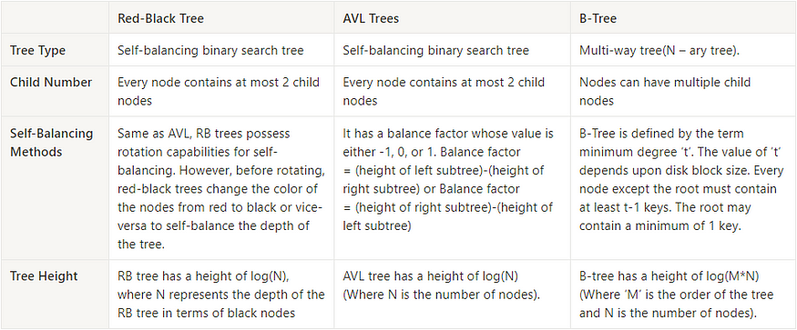

AVL Vs RB Vs B-Tree
The height ( h ) of a B-tree is given by:
$$h≤\left\lceil {}_{log{}\left\lceil m/2\right\rceil }\frac{n+1}{2}\right\rceil −1$$

Slide 6
Properties of RB Tree
Root is always black
Nil is considered to be black which means that every non-Nil node has two children
Black Children Rule: children of each red node are black
Black Height Rule: For each node v, there exist an integer bh(v) such that each downward path from v to a nil has exactly bh(v) black real(ie non nill) nodes.

Slide 7
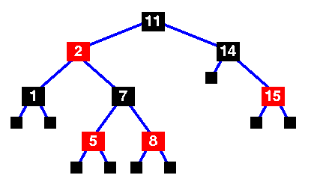
Ex- RB Tree

Slide 8
Rotations
x
A C
B
C
A B
The rotations do not break BST- property
The order (AxByC is preserved)
Left Rotate (T, x)
y
y
Right Rotate (T, x)
x

Slide 9
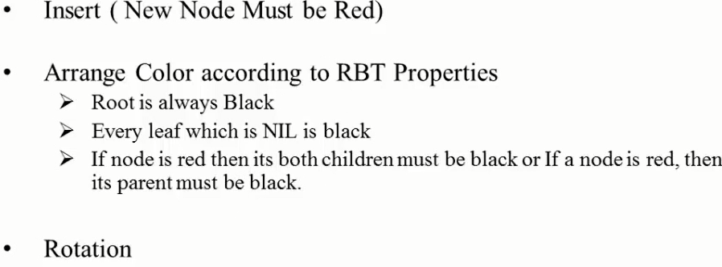
Insertion

Slide 10
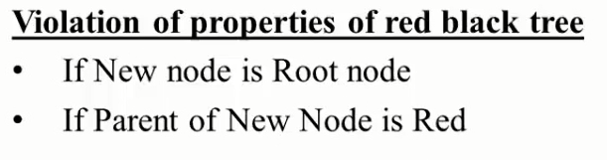
The type of discrepancy is determined by
➔the location of the node with respect to its grand parent, and
➔ the color of the sibling of the parent

Slide 11
1. where the parent sibling (uncle) is red : fixed by changing color
2 where the parent sibling (uncle) is black : fixed by rotations
Discrepancies
(note: at most one rotation is sufficient for fixing the problem)

Slide 12
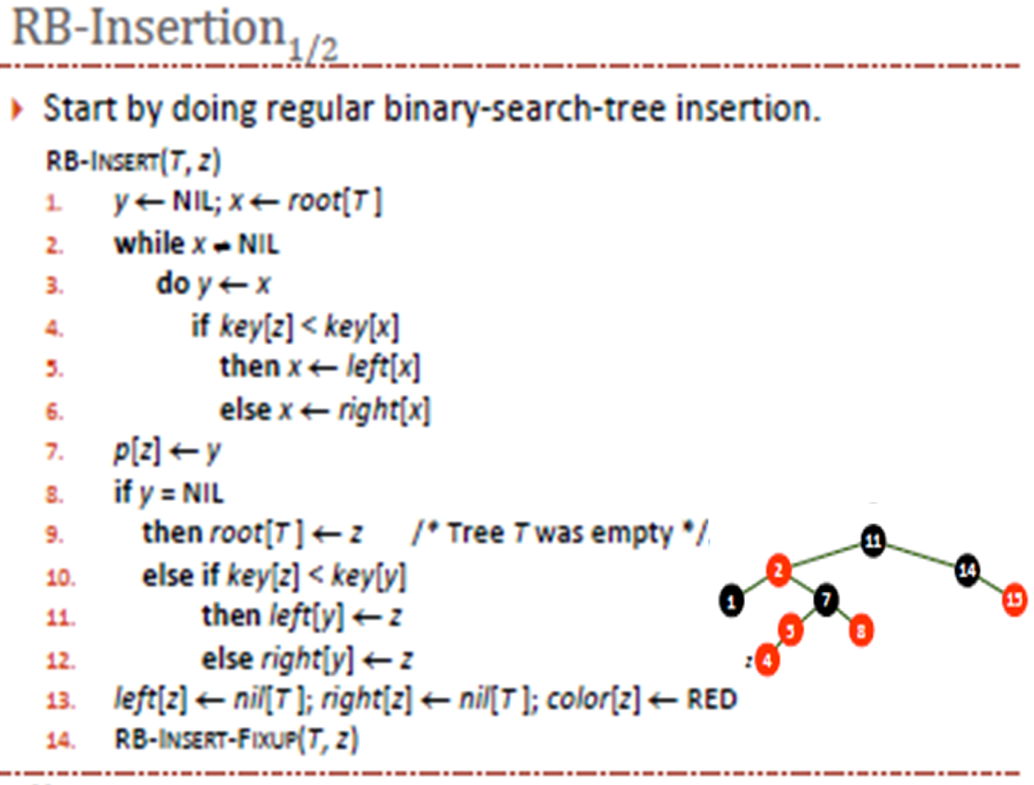

Slide 13
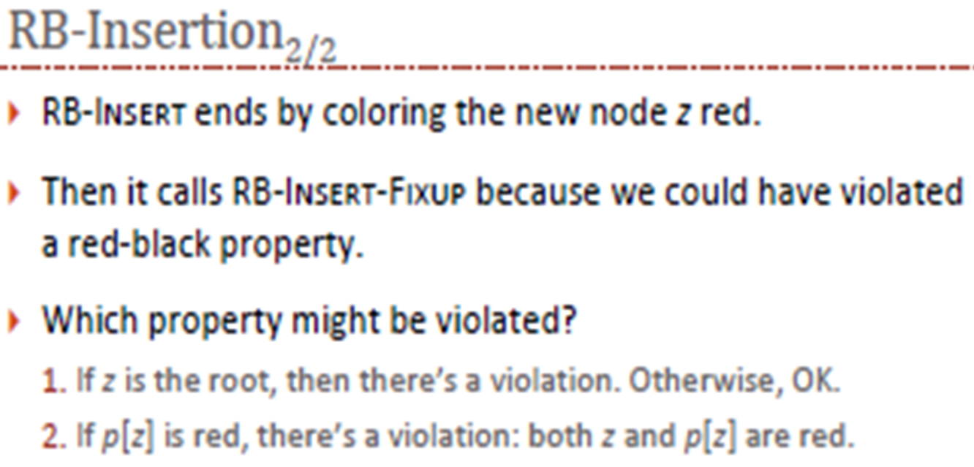

Slide 14
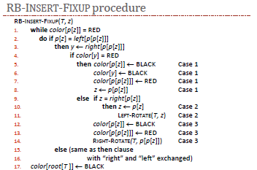

Slide 15
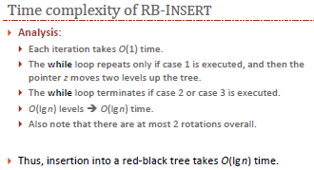

Slide 16
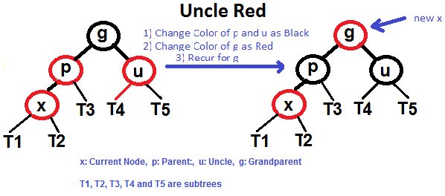
Understanding Insertion
Let x be the newly inserted node.
1) Perform standard BST insertion and make the color of newly inserted nodes as RED.
2) If x is root, change color of x as BLACK
3) Do following if color of x’s parent is not BLACK or x is not root.
a) If x’s uncle is RED (case1)
(i) Change color of parent and uncle as BLACK.
(ii) color of grand parent as RED.
(iii) Change x = x’s grandparent, repeat steps 2 and 3 for new x.

Slide 17
b) If x’s uncle is BLACK,
then there can be four configurations for x, x’s parent (p) and x’s grandparent (g)
i) Left Left Case (p is left child of g and x is left child of p)
ii) Left Right Case (p is left child of g and x is right child of p)
iii) Right Right Case (Mirror case i)
iv) Right Left Case (Mirror case ii)

Slide 18
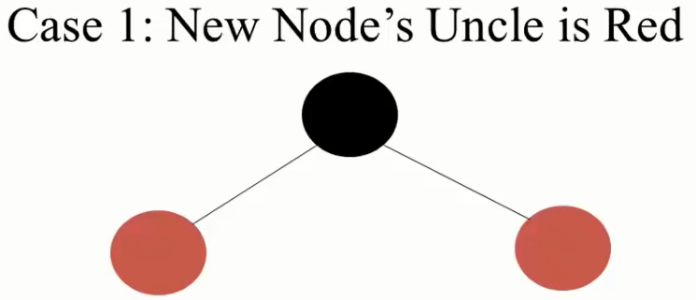
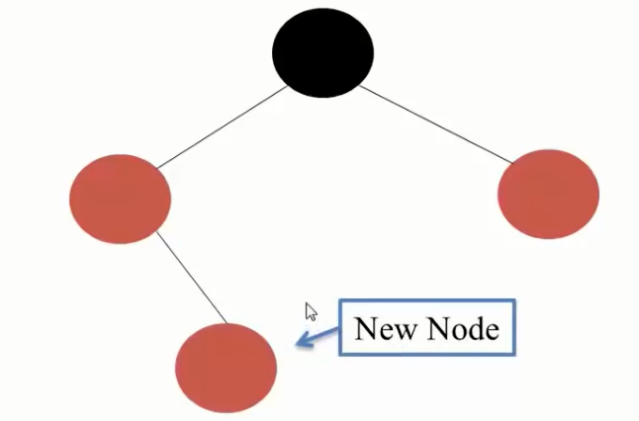
Inserting a new node
Strategy to resolve :
CHANGE COLOR
Change Color of Grand Parent of New Node
Change Color of Parent and Uncle of New Node
Grandparent will be marked as New Node

Slide 19
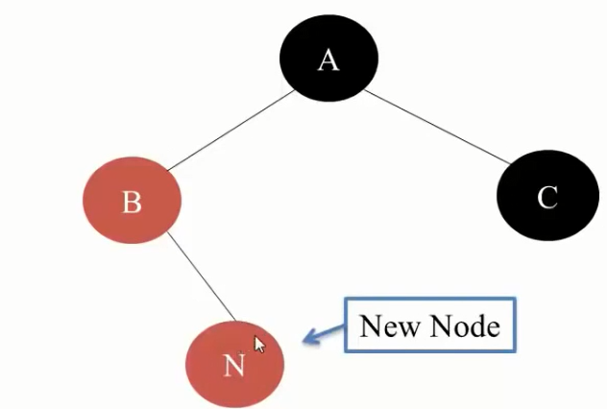
Strategy to resolve :
ROTATION
Anti Clockwise Rotation at Parent Node
Make Parent as New Node

Slide 20
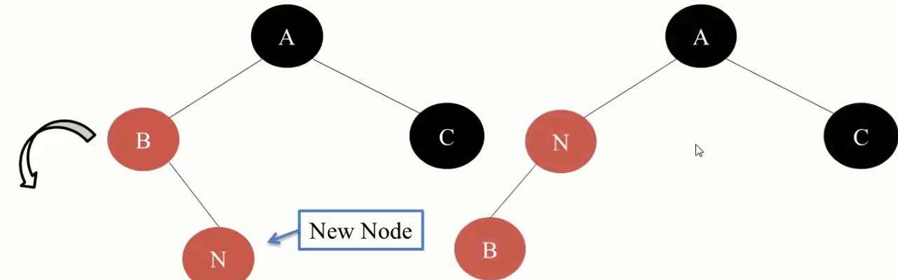
Strategy to resolve :
ROTATION
Anti Clockwise Rotation at Parent Node
Make Parent as New Node

Slide 21
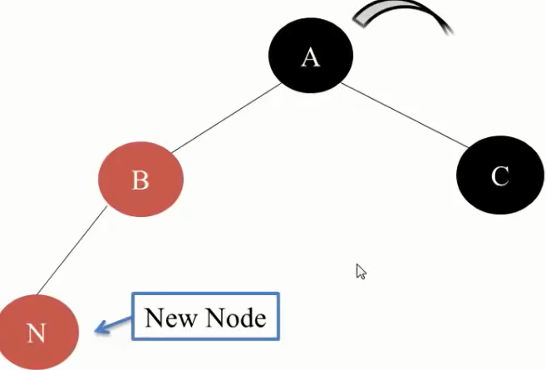
Case 3
Strategy to resolve :
ROTATION & COLOR CHANGE
Clockwise Rotation at GrandParent Node
Exchange Color of GrandParent and Parent

Slide 22

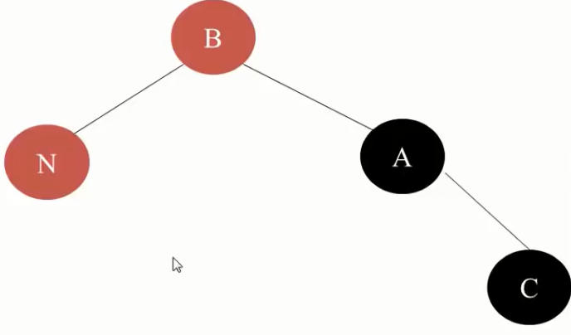
Case 3
BLACK
RED

Slide 23
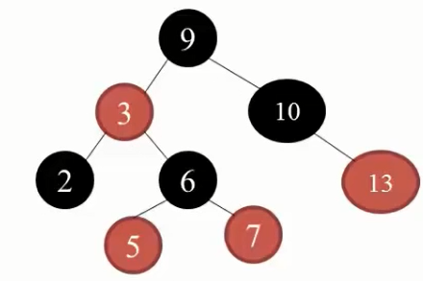
Example

Slide 24
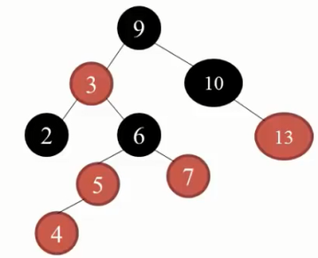
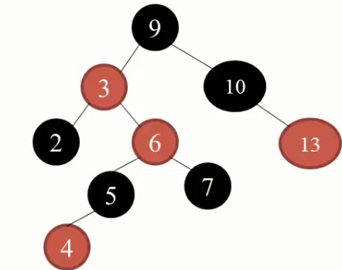
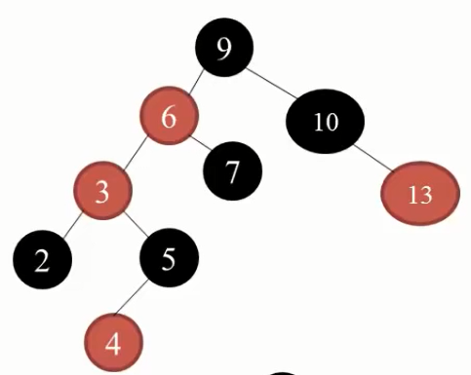
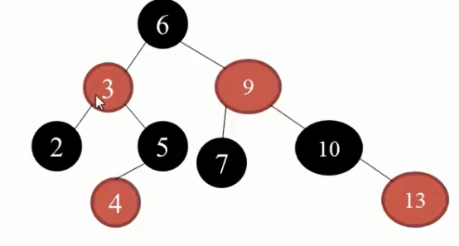
Change Color of Grand Parent of New Node
Change Color of Parent and Uncle of New Node
Grandparent will be marked as New Node
Case-1
Insert 4
x
x
Case-3
Case-2
Clockwise Rotation at GrandParent Node
Exchange Color of GrandParent and Parent
Anti Clockwise Rotation at Parent Node
Make Parent as New Node

Slide 25
Insert following nodes in an empty RB Tree
41, 38,31, 12, 19, 8
5, 10, 15, 25, 20, 30

Slide 26
Exercises
-1 Draw the complete binary search tree of height 3 on the keys {1, 2, . . . , 15}. Add the NIL leaves and color the nodes in three different ways such that the black-heights of the resulting red-black trees are 2, 3, and 4.
-2 Suppose that the root of a red-black tree is red. If we make it black, does the tree remain a red-black tree?

Slide 27
Video Lecture of the topic can be found at
Red Black Tree and Insertion
https://www.youtube.com/watch?v=H0MutN9u-Ik
Understanding RB Tree Deletion cases with an Example
https://youtu.be/1qEjtfR0gIo
How To Perform Search & Insert Operation In Binary Search Tree (BST)
https://www.youtube.com/watch?v=smE0gHcd5Gg

